Slide 1
Customer Retention Project
- Sumit Dhandhania

Slide 2
Contents
About The Project
Problem Statement
Customer Retention in Brief
Findings
Suggestions
Conclusion

Slide 3
About The Project
The Emerging trend of online shopping
Factors influencing online shopping
Data distribution
Growth and fall of the e-shopping model

Slide 4
Problem Statement
The area of concern is to attract users to make a purchase
Getting users loyalty is the aim behind this research

Slide 5
Customer Retention in Brief
Repeat purchasing of an user is known to be customer retention in most basic sense.
Due to customer retention a business shows better probability for flourishment
Another boon derived from customer retention is the positives our users spread generating more customers for the business

Slide 6
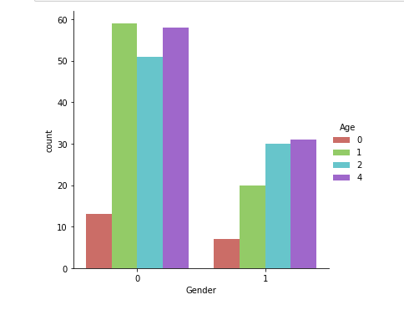
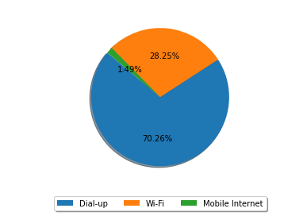
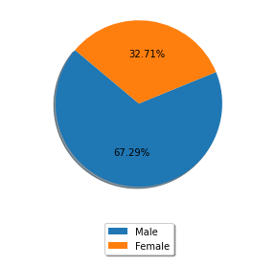
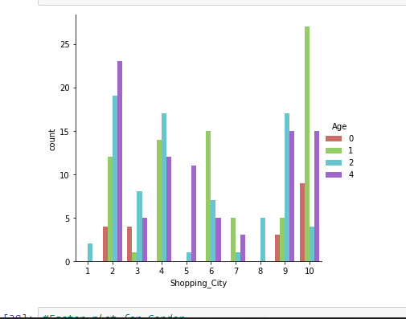
Findings

Slide 7
Findings
There are more females (67.29%) than males(32.71%) for shopping online
The maximum shoppers is from 31-40 years (30.11%), closely followed by 21-30 years (29.37%) and least is of 51 years and above (7.06%). The reason can be due to lack of tech-savvy age group.
Mobile phones and mobile internet is the most used channel depicting convenience
Faster and convenient experience of shopping draws the users to any e-retailer
Wide range of products and payment facilitation is an add-on benefit

Slide 8
Findings
Trust by the user happens to be the base for customer retention
This trust is shown by the e-retailers through delivering the product on time, complete information on seller and the product, having a good return policy and by securing the privacy of customer and their data

Slide 9
Suggestions
Tie-ups with payment channels for some exclusive benefits can lure the users
Disruptions needs to be minimum
Some more comparison feature can help the end-user to remain loyal to the brand
Easy and complete details help the purchaser to make decisions
An AI must be tested to highlight the key points of differences between the product desired and similar products available

Slide 10
Conclusion
Customers decide the survival and prosperity of any business
Trust, benefits, security, complete relevant information and ease forms the main pillars for e-retail business
As per the data amazon.in and flipkart.com are the front-runners
Paytm, Myntra and snapdeal are in the concern area for survival

Slide 11
Thank You

